Slide 1


Limerock Park Database Design Proposal
Created by Mark Lozinski

Slide 2
Table of Contents
Executive Summary.....................................................................................................3
Entity Relationship Diagram………............................................................................4
Tables………………………………………………………………………………………5-13

Slide 3
Executive Summary
Located in Lakeville, Connecticut the Limerock Park Raceway hosts NASCAR Busch, Professional SportsCar and SCCA Pro Racing organization events. Limerock is host to over 250 different racers and almost 300 cars throughout the months from May to September, thus it is imperative that the data for each race be both well organized and easily accessible.
This presentation will walk you through the various things that comes along with each race from the list of people racing that day to the class that they fall into down to the number of people that attended the race that day.

Slide 4
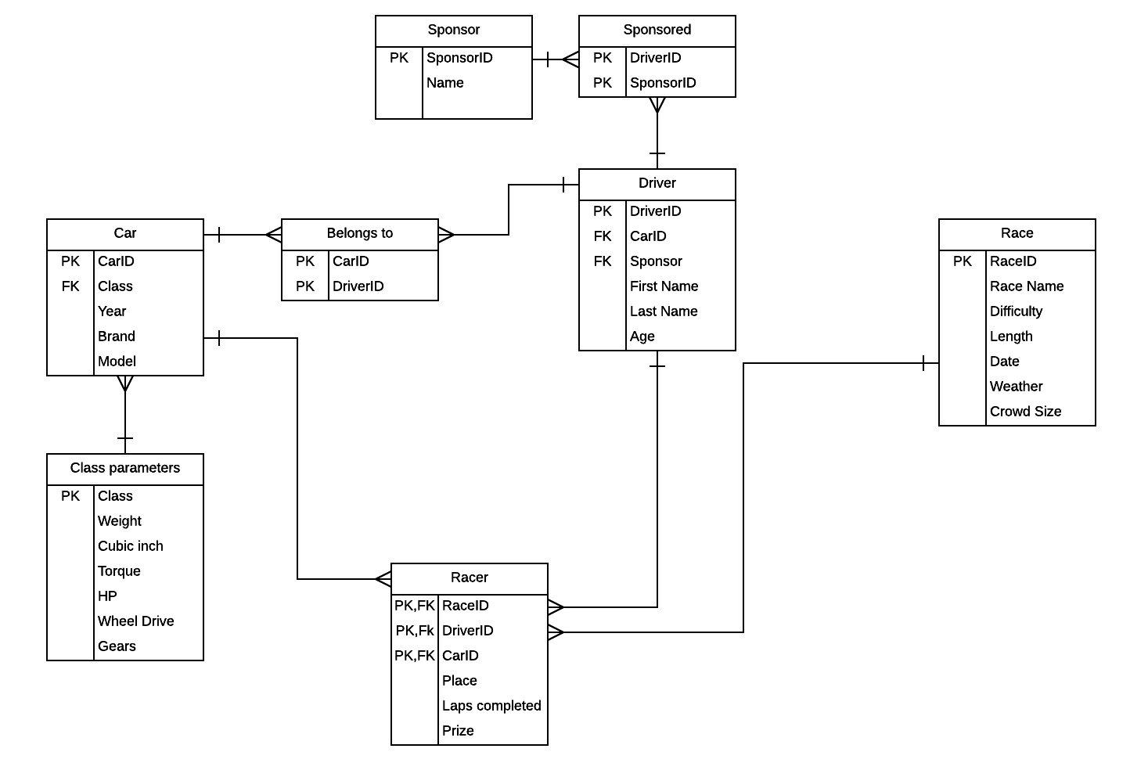

Slide 5
Drivers Table
This table shows all of the Drivers that will be participating throughout the year in the various races hosted by Limerock.
CREATE TABLE IF NOT EXISTS Drivers (
DriverID char(4) not null,
CarID char(4) not null,
SponsorID char(4) not null,
First_Name VARCHAR (25) not null,
Last_Name VARCHAR (25) not null,
Age Integer not null,
Foreign key(CarID) references Cars(CarID),
Foreign key(SponsorID) references Sponsors(SponsorID),
primary key(DriverID)
);
DriverID | CarID | SponsorID | First_Name | Last_Name | Age
D01 | C01 | S01 | Mark | Lozinski | 19
D02 | C02 | S02 | AJ | Lorenzetti | 19
D03 | C03 | S03 | Kyle | Maclean | 20
D04 | C04 | S04 | Jon | Hylan | 20
D05 | C05 | S01 | Joey | Wilkinson | 21
D06 | C06 | S05 | Teddy | Morgues | 19
D07 | C06 | S03 | Alan | Labouseur | 20
Dependencies:
DriverID -> CarID, SponsorID, First_Name, Last_Name, Age

Slide 6
Cars Table
This table shows all of the Cars that will be driven throughout the year by the drivers listed in the last table.
CREATE TABLE IF NOT EXISTS Cars (
CarID char(4) not null,
Spec integer not null,
Year Integer not null,
Brand VARCHAR (25) not null,
Model VARCHAR (25) not null,
foreign key (Spec) references Spec_Parameters(Spec),
primary key(CarID)
);
CarID | Spec | Year | Brand | Model
C01 | 1 | 2005 | Pontiac | Grand am GT
C02 | 3 | 2013 | Audi | RS5
C03 | 3 | 2010 | Nissan | GTR
C04 | 2 | 2005 | BMW | M3
C05 | 1 | 2004 | Subaru | STI
C06 | 2 | 2001 | Honda | S2000
C07 | 4 | 2017 | Porsche | GT3-RS
Dependencies:
CarID -> Spec, Year, Brand, Model

Slide 7
Belongs_to Table
This table shows what Car belongs to the drivers that compete in the races.
CREATE TABLE IF NOT EXISTS Belongs_to (
CarID char(4) not null,
DriverID char(4) not null,
Foreign key(CarID) references Cars(CarID),
Foreign key(DriverID) references Drivers(DriverID),
primary key(CarID, DriverID)
);
CarID | DriverID
C01 | D01
C02 | D02
C03 | D03
C04 | D04
C05 | D05
C06 | D06
C07 | D07
Dependencies:None
Composite Key attributes: DriverID, CarID

Slide 8
Spec_Parameters Table
This table shows all of the requirements that a car must be able to meet in order to race in a certain league. These leagues are divided into different specs.
CREATE TABLE IF NOT EXISTS Spec_Parameters (
Spec integer not null,
Min_Weight_lbs integer not null,
Max_Cubic_inch integer not null,
Max_Torque integer not null,
Max_HorsePower integer not null,
primary key(Spec)
);
Spec | Min_ Weight | Max_ Cubic_ Inch | Max_ Torque | Max_ HorsePower
1 | 3200 | 440 | 400 | 385
2 | 2800 | 600 | 580 | 550
3 | 2600 | 675 | 760 | 725
4 | 2450 | 800 | 900 | 875
Dependencies:
Spec -> Min_weight, Max_Cubic_inch_, Max_torque, Max_Horsepower

Slide 9
Sponsor Table
This table shows all of the Sponsors that the drivers have. Some sponsors sponsor more than one driver and some drivers have more than one sponsor.
CREATE TABLE IF NOT EXISTS Sponsors (
SponsorID char(4) not null,
Sponsor_Name VARCHAR (25) not null,
primary key(SponsorID)
);
SponsorID | Sponsor_Name
S01 | Patron
S02 | Citgo
S03 | Quest Software
S04 | True Value
S05 | Green Global
S06 | Flying Lizard
S07 | Pepsi
S08 | Tropicana
Dependencies:
SponsorID -> Sponsor_Name

Slide 10
Sponsored Table
This table shows what Driver is sponsored by what Sponsor.
CREATE TABLE IF NOT EXISTS Sponsored (
SponsorID char(4) not null,
DriverID char(4) not null,
Foreign key(SponsorID) references Sponsors(SponsorID),
Foreign key(DriverID) references Drivers(DriverID), primary key(SponsorID, DriverID)
);
SponsorID | DriverID
S01 | D01
S02 | D02
S03 | D03
S04 | D04
S01 | D05
S05 | D06
S03 | D07
S08 | D05
S06 | D04
S07 | D01
Dependencies:None
Composite Key attributes: DriverID, SponsorID

Slide 11
Races Table
This table shows some of races that the drivers will compete in throughout the season and some insight to how the conditions were.
CREATE TABLE IF NOT EXISTS Races (
RaceID char(4) not null,
Race_Name VARCHAR (25) not null,
Difficulty VARCHAR (25) not null,
Crowd_Size integer not null,
Date VARCHAR (25) not null,
Weather VARCHAR (25) not null,
primary key(RaceID)
);
RaceID | Race_Name | Difficulty | Crowd_Size | Date | Weather
R01 | EMRA PM | Med | 31,000 | 05/08/17 | Sunny
R02 | PCA CVR | Med | 23,000 | 05/29/17 | Sunny
R03 | BMW CT Valley- Autocross | Low | 19,000 | 06/12/17 | Overcast
R04 | Lime Rock Drivers Club | High | 29,000 | 06/12/17 | Overcast
Dependencies:
RaceID -> race_name, difficulty, crowd size, weather

Slide 12
Racers Table
This table the race, drivers, and the cars they are driving for the races. In addition the table tells you what place ethe driver came in and what the prize money was.
CREATE TABLE IF NOT EXISTS Racers (
RaceID char(4) not null,
DriverID char(4) not null,
CarID char(4) not null,
Place VARCHAR (25) not null,
Laps_completed integer not null,
Prize_in_USD integer not null,
Foreign key(RaceID) references Races(RaceID),
Foreign key(DriverID) references Drivers(DriverID),
Foreign key(CarID) references Cars(CarID),
primary key(RaceID,DriverID,CarID)
);
Dependencies:
RaceID, CarID, DriverID -> Place, Laps Completed, Prize_in_USD
TABLE ON NEXT SLIDE

Slide 13
RaceID | DriverID | CarID | Place | Laps_Completed | Prize_in_USD
R01 | D01 | C01 | First | 144 | $9,000
R02 | D02 | C02 | Third | 164 | $7,000
R02 | D03 | C03 | Second | 167 | $1,100
R03 | D04 | C04 | First | 157 | $10,000
R01 | D05 | C05 | Forth | 131 | $1,000
R03 | D06 | C06 | Third | 149 | $6,000
R04 | D07 | C07 | First | 177 | $25,000

Slide 14
Belongs_to_Filled
This view is used as a way to see what the Belongs_to table is meant to show, but instead of having to cycle between them, it shows the car that the driver drives next to it.
CREATE OR REPLACE VIEW Belongs_to_Filled AS
SELECT
d.first_name,
d.last_name,
c.year,
c.brand,
c.model
FROM Drivers d,
Cars c
WHERE d.CarID = c.CarID
ORDER BY d.last_name DESC
First_Name | Last_Name | Year | Brand | Model
Mark | Lozinski | 2005 | Pontiac | Grand am GT
AJ | Lorenzetti | 2013 | Audi | RS5
Kyle | Maclean | 2010 | Nissan | GTR
Jon | Hylan | 2005 | BMW | M3
Joey | Wilkinson | 2004 | Subaru | STI
Teddy | Morgues | 2001 | Honda | S2000
Alan | Labouseur | 2017 | Porsche | GT3-RS

Slide 15
Let’S_Race View
This view shows what race is happening, who is racing and the cars that they are racing in along with the difficulty of the race.
CREATE OR REPLACE VIEW Lets_Race AS
SELECT
r.race_name,
r.difficulty
d.first_name,
d.last_name,
c.spec,
c.year,
c.brand,
c.model
FROM Drivers d,
Cars c,
Races r
WHERE d.CarID = c.CarID
ORDER BY d.last_name DESC
Table on next page

Slide 16
Race_ Name | First_Name | Difficulty | Last_Name | Year | Brand | Model
EMRA PM | Mark | Med | Lozinski | 2005 | Pontiac | Grand am GT
PCA CVR | AJ | Med | Lorenzetti | 2013 | Audi | RS5
PCA CVR | Kyle | Med | Maclean | 2010 | Nissan | GTR
BMW CT Valley- Autocross | Jon | Low | Hylan | 2005 | BMW | M3
EMRA PM | Joey | Med | Wilkinson | 2004 | Subaru | STI
BMW CT Valley- Autocross | Teddy | Low | Morgues | 2001 | Honda | S2000
Lime Rock Drivers Club | Alan | High | Labouseur | 2017 | Porsche | GT3-RS

Slide 17
Query: Attendance: This query would allow for you to check the average attendance for each race in order to be able to figure out which races are more popular than the others in order to market better for the future
SELECT r.RaceID AS RaceID,
r.Race_Name AS Name,
avg(r.Crowd_Size) AS Avg_Crowd_Size
FROM Races r
WHERE r.Crowd_Size IS NOT NULL
GROUP BY r.RaceID;

Slide 18
Query The_Bill: Unfortunately all of the prize money that the racers win as prize money is not theirs and they must pay a small fee to the track after the race. This query shows how much each racer owes after each race
SELECT (r.Prize_in_USD * .05) AS The_Bill,
d.first_name AS First_Name,
d.last_name AS Last_Name
FROM Drivers d,
Racers r
WHERE r.DriverID = d.DriverID
GROUP BY The_Bill;

Slide 19
Stored Procedure: Late Entry- Although it is very annoying, some people manage to weasel their way into the races even after the closing dates of registration and thus the drivers list needs to be updated.
CREATE OR REPLACE FUNCTION new_driver()
RETURNS trigger AS $$ BEGIN IF NEW.is_driver = true
THEN INSERT INTO Drivers VALUES(NEW.DriverID, NEW.CarID, NEW.SponsorID, NEW.DriverID, NEW.First_Name, NEW.Last_Name, NEW.Age );
END IF;
RETURN NEW;
END;
$$ LANGUAGE plpgsql

Slide 20
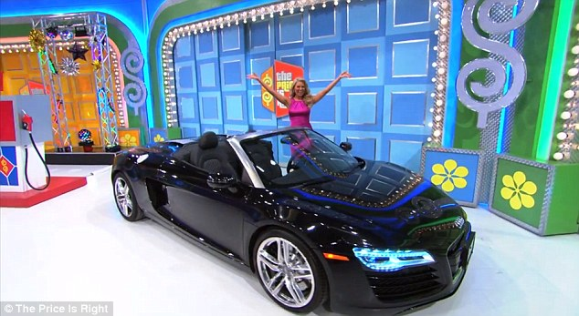
Stored Procedure: A Brand New Car!!- Sometimes a driver will get a new car to compete in a new division, but still wants to keep his old car on the active roster. This requires us to not just update the Cars Table, but the belongs_to table as well.
CREATE OR REPLACE FUNCTION new_car()
RETURNS trigger AS $$
BEGIN IF NEW.is_employee = true THEN
INSERT INTO Cars VALUES(NEW.CarID, NEW.Spec, NEW.year, NEW.Brand, NEW.Model);
INSERT INTO Belongs_to VALUES (NEW.CarID, NEW.DriverID)
END IF;
RETURN NEW;
END;
$$ LANGUAGE plpgsql
Sorry, I couldn’t resist The price is right reference

Slide 21
Triggers: The first trigger that we have is one that we would use to add a new driver to the list of active drivers in a race and the second one we have is the one that you would use to add a new car to an old driver.
Trigger 1:
CREATE TRIGGER add_driver
AFTER INSERT OR UPDATE ON Driver
FOR EACH ROW
EXECUTE PROCEDURE new_diver();
Trigger 2:
CREATE TRIGGER add_car
AFTER INSERT OR UPDATE ON Driver
FOR EACH ROW
EXECUTE PROCEDURE new_car();

Slide 22
Security Admin: High ranking officials who need access to the entire Limerock database.
CREATE ROLE admin;
GRANT ALL ON ALL TABLES
IN SCHEMA PUBLIC
TO admin;
Race Makers: The other group of people that get rights to change the database is the people that are decide what races are going to be held, who is allowed to race and what the specs on the cars must be.
CREATE ROLE race_manager;
GRANT SELECT, INSERT, UPDATE ON Races, Drivers, Spec_Parameters TO race_manager;

Slide 23
Implementation Notes, Known Problems & Future Enhancements
This database is relatively simple mostly because of the fact that if I went even 1 step smaller, this database would have been minimum 18 more tables (yes I did actually try to do flesh it out and it didn’t work out). This means that this presentation just deals with the basics of this subject and thus can be added on to greatly
The issue with this database is that it currently doesn’t factor in the fact that some races are team based and add a number of factors such as pit crew, time driving, car splitting, and benching just to name a few
In the future this data base would be upgraded to included the problems above and also be able to be integrated to include race data about drivers that didn’t happen on this track and people would be able to get a better understanding of what is shown on this table on a year-wide basis.

